Slide 1
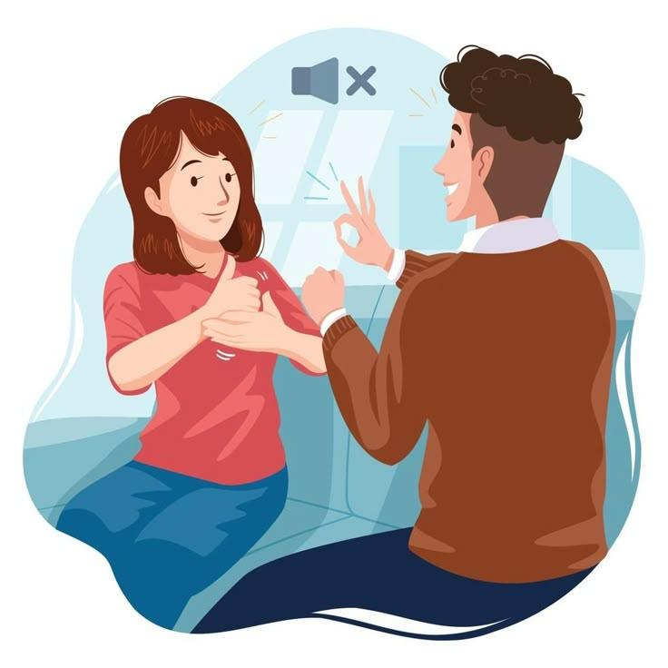
SIGN LANGUAGE TRANSLATION USING
DEEP LEARNING &
COMPUTER VISION
Presented by : Khushbu Pandya (IAR/12989) Kush Patel (IAR/14740)

Slide 2
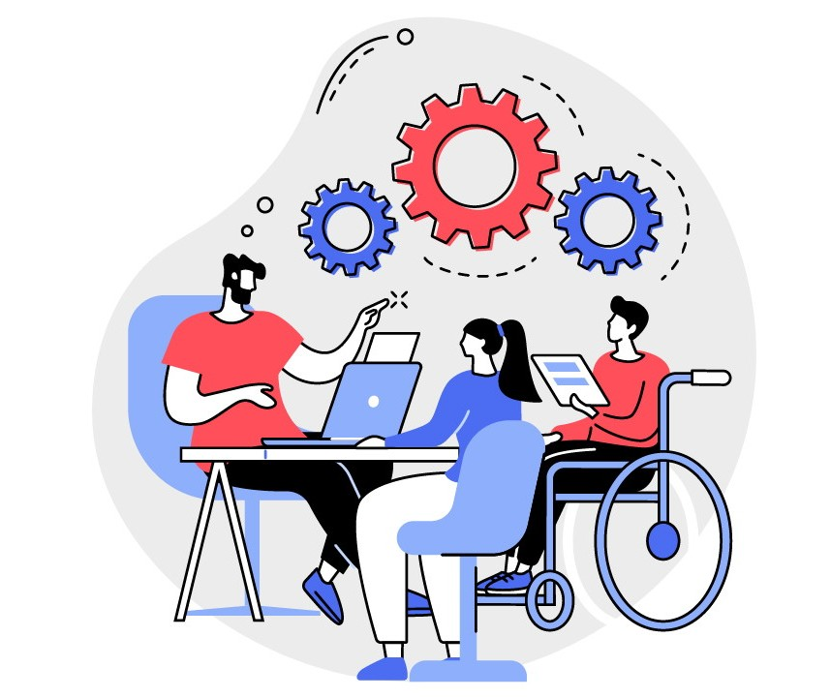
ABSTRACT
A real-time system that recognizes hand gestures using a Random Forest-based machine learning model and translates them into text for communication accessibility.

Slide 3
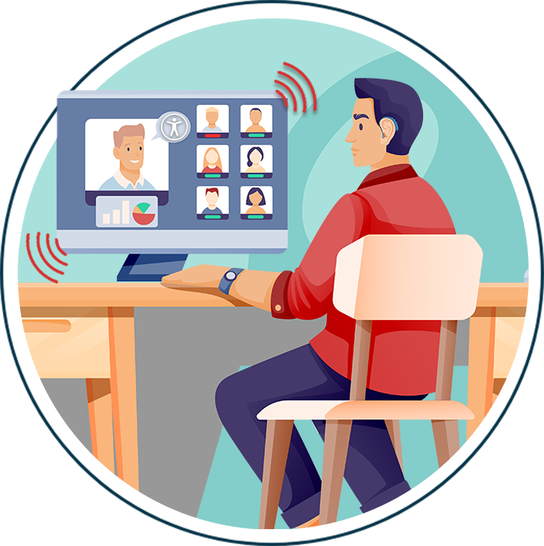
MOTIVATION
Communication barriers for hearing-impaired people
Social importance of accessibility
Advancement in AI and computer vision
Need for a cost-effective solution

Slide 4
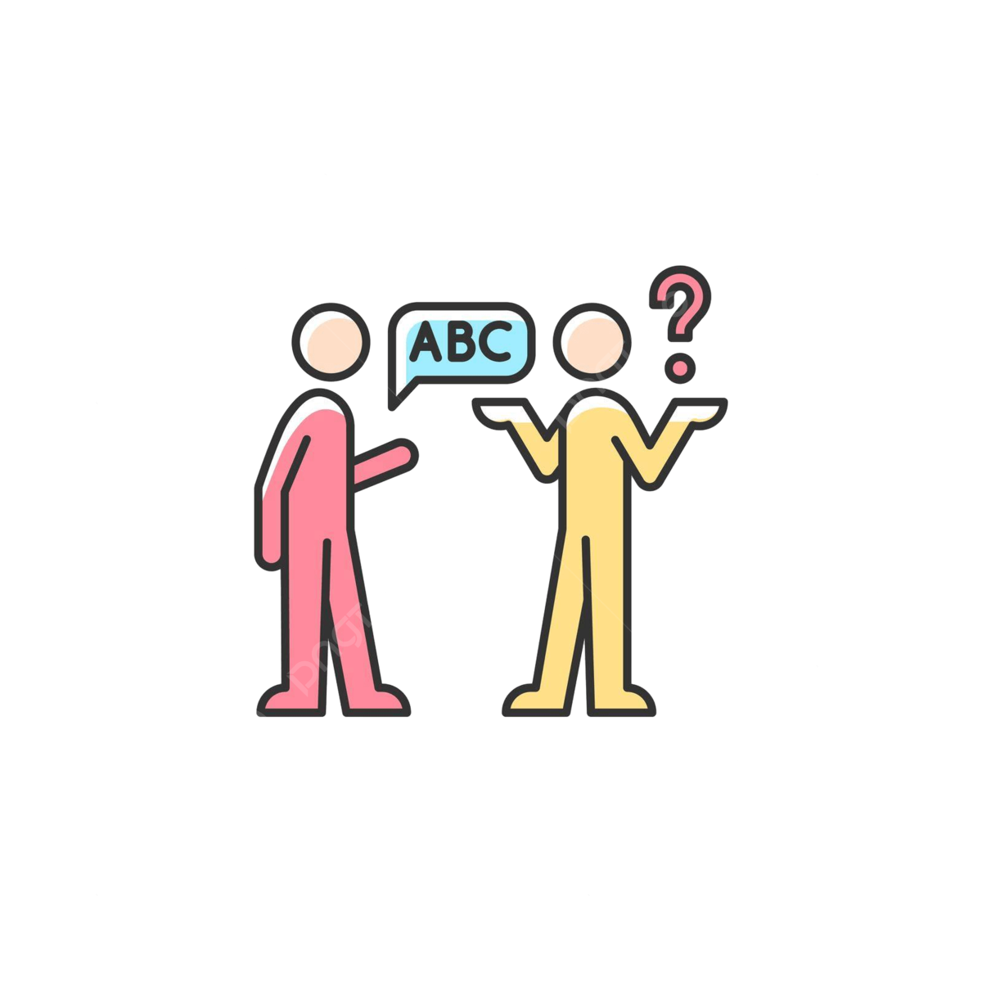
PROBLEM STATEMENT
Hearing-impaired individuals struggle to communicate because most people do not understand sign language. Human interpreters are limited, costly, and unavailable at all times. Hence, an automated translation system is required.

Slide 5
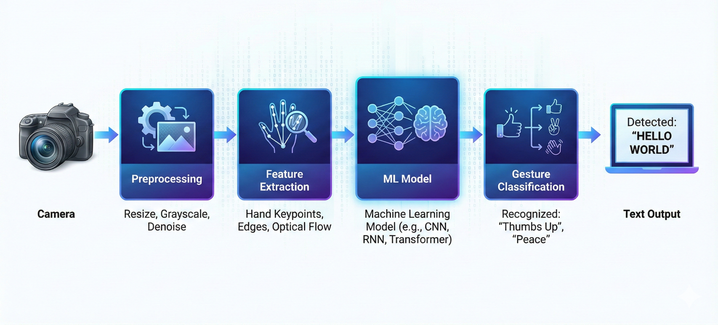
SYSTEM ARCHITECTURE

Slide 6
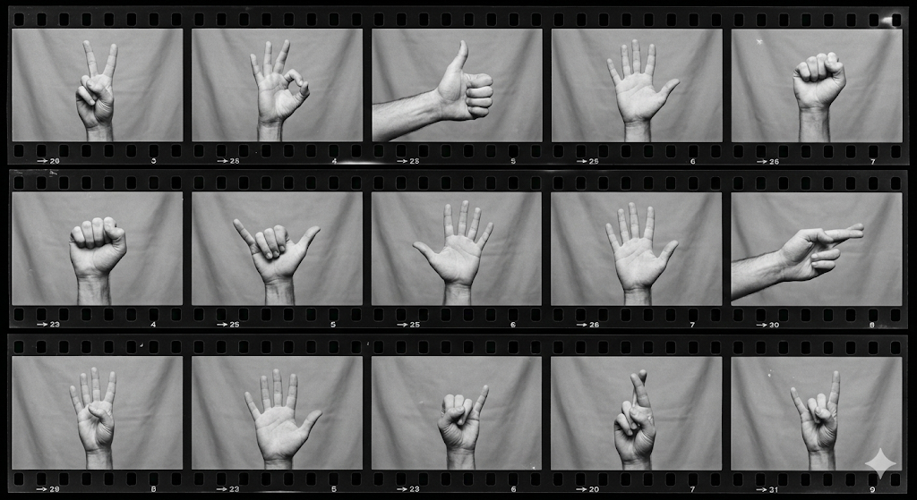
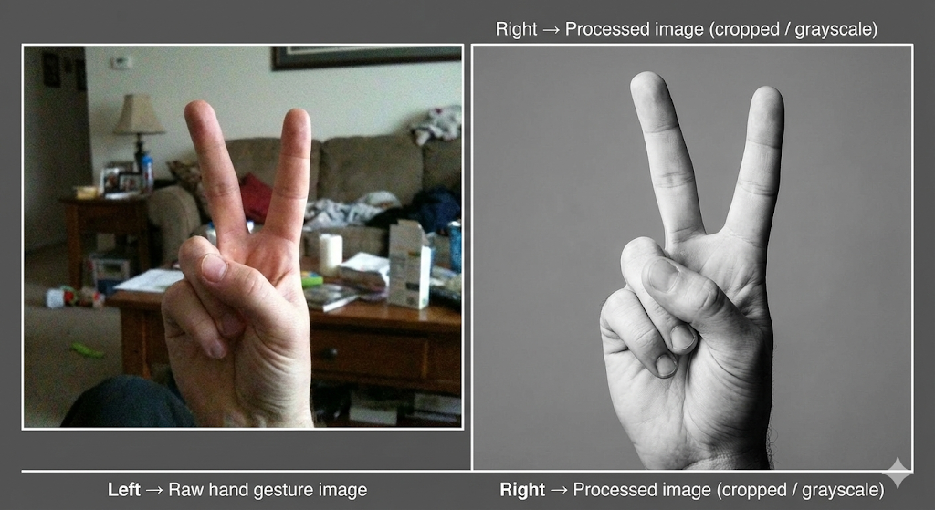
DATASET & PREPROCESSING

Slide 7
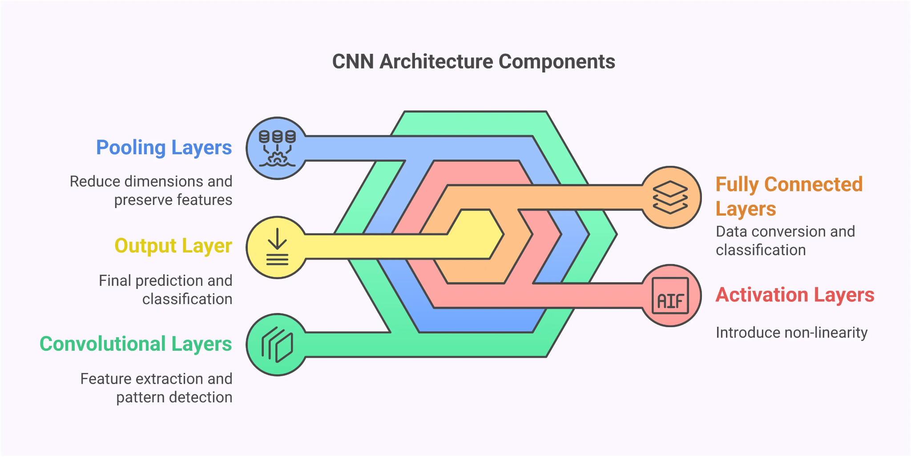
MACHINE LEARNING MODEL
CNN is used for image classification
Automatically extracts features
Consists of Conv, Pooling & Dense layers
Provides high accuracy for gesture recognition

Slide 8
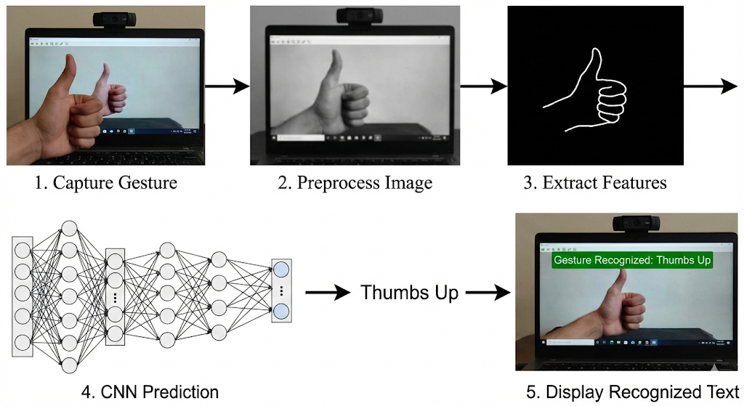
WORKING OF THE SYSTEM
Capture gesture using webcam
Preprocess the image
Extract features
CNN prediction
Display recognized text

Slide 9
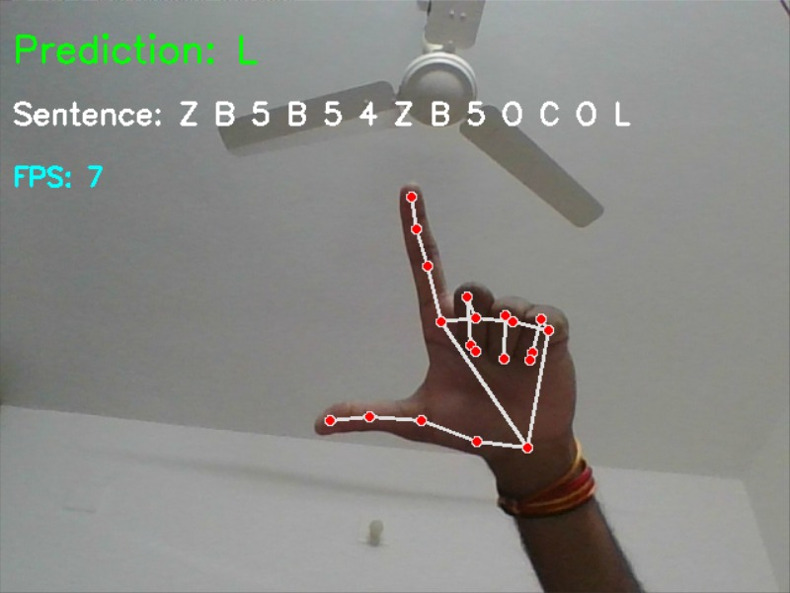
RESULT & OUTPUT

Slide 10
REFERENCES
Research Papers:
Zhang, L., et al. “Hand Gesture Recognition Using MediaPipe in Real-Time Systems.” IEEE International Conference on Image Processing, 2022.
Dong, C., Fang, Z., & Gao, Z. “Static Sign Language Recognition Using Keypoint Extraction and Neural Networks.” Journal of Computer Vision Research, 2021.
Koller, O., et al. “Deep Learning for Sign Language Recognition.” IEEE Transactions on Pattern Analysis and Machine Intelligence, 2019.
He, K., et al. “Delving Deep into Hand Gesture Recognition.” ACM Computer Vision and Pattern Recognition, 2020.
Online Sources:
Google, “MediaPipe Hands: Real-time 3D Hand Tracking.” Available at: https://developers.google.com/mediapipe
OpenCV Documentation. “VideoCapture and Drawing Functions.” https://docs.opencv.org
TensorFlow Documentation. “Building Neural Networks with Keras.” https://www.tensorflow.org
Scikit-Learn. “MLPClassifier Documentation.” https://scikit-learn.org

Slide 11
CONCLUSION
The Sign Language Translation System successfully demonstrates real-time recognition of hand gestures using machine learning.
The system effectively converts gestures into readable text, helping to reduce the communication gap between hearing-impaired and normal individuals.
The use of computer vision and CNN provides good accuracy and fast performance.
This project proves that AI-based assistive technology can be implemented in a low-cost and user-friendly manner for social benefit.

Slide 12
THANK YOU!

